Slide 1
LECTURE 04
Project Integration Management

Slide 2
Learning Objectives
Describe an overall framework for project integration management as it relates to the other project management knowledge areas and the project life cycle
Discuss the strategic planning process and apply different project selection methods
Explain the importance of creating a project charter to formally initiate projects
Describe project management plan development, understand the content of these plans, and review approaches for creating them

Slide 3
Learning Objectives
Explain project execution, its relationship to project planning, the factors related to successful results, and tools and techniques to assist in directing and managing project work
Describe the process of monitoring and controlling a project
Understand the integrated change control process, planning for and managing changes on information technology (IT) projects, and developing and using a change control system
Explain the importance of developing and following good procedures for closing projects
Describe how software can assist in project integration management

Slide 4
Project Integration Management Processes
Developing the project charter involves working with stakeholders to create the document that formally authorizes a project—the charter
Developing the project management plan involves coordinating all planning efforts to create a consistent, coherent document—the project management plan
Directing and managing project work involves carrying out the project management plan by performing the activities included in it

Slide 5
Project Integration Management Processes
Monitoring and controlling project work involves overseeing activities to meet the performance objectives of the project
Performing integrated change control involves identifying, evaluating, and managing changes throughout the project life cycle
Closing the project or phase involves finalizing all activities to formally close the project or phase

Slide 6
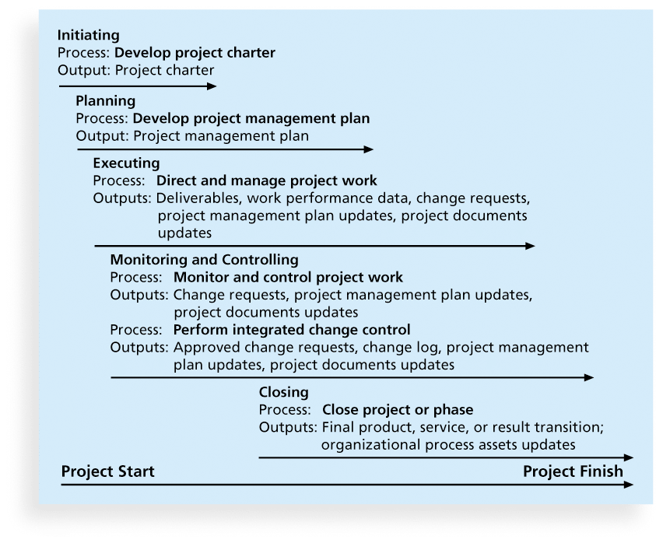
Figure 4-1. Project Integration Management Summary

Slide 7
Strategic Planning and Project Selection
Strategic planning involves determining long-term objectives, predicting future trends, and projecting the need for new products and services
Organizations often perform a SWOT analysis
analyzing Strengths, Weaknesses, Opportunities, and Threats
As part of strategic planning, organizations
identify potential projects
use realistic methods to select which projects to work on
formalize project initiation by issuing a project charter

Slide 8
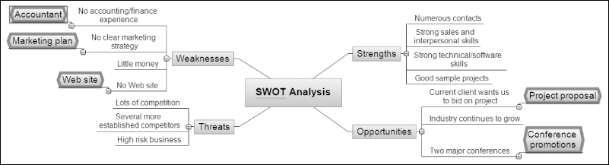
Figure 4-2. Mind Map of a SWOT Analysis to Help Identify Potential Projects

Slide 9
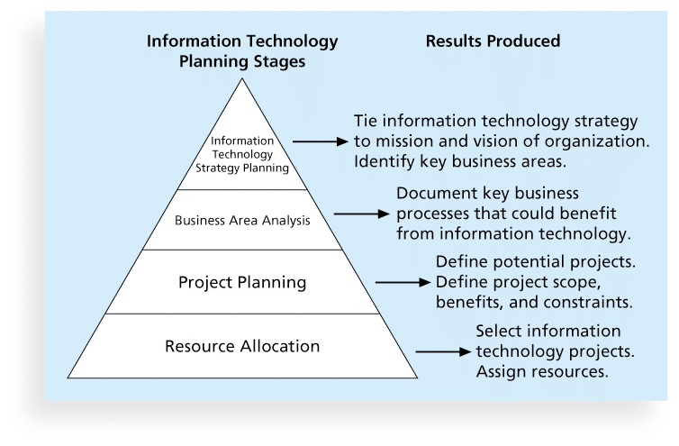
Figure 4-3. Information Technology Planning Process

Slide 10
Best Practices
A 2013 survey identified companies most admired for their ability to apply IT-related business capabilities for competitive advantage
Best practices of these companies include:
Customer-driven IT is essential
IT can enable branding and customer recruitment
Keep improving

Slide 11
Methods for Selecting Projects
There are usually more projects than available time and resources to implement them
Methods for selecting projects include:
focusing on broad organizational needs
categorizing information technology projects
performing net present value or other financial analyses
using a weighted scoring model
implementing a balanced scorecard

Slide 12
Financial Analysis of Projects
Financial considerations are often an important consideration in selecting projects
Three primary methods for determining the projected financial value of projects:
Net present value (NPV) analysis
Return on investment (ROI)
Payback analysis

Slide 13
Net Present Value Analysis
Net present value (NPV) analysis is a method of calculating the expected net monetary gain or loss from a project by discounting all expected future cash inflows and outflows to the present point in time
Projects with a positive NPV should be considered if financial value is a key criterion
The higher the NPV, the better

Slide 14
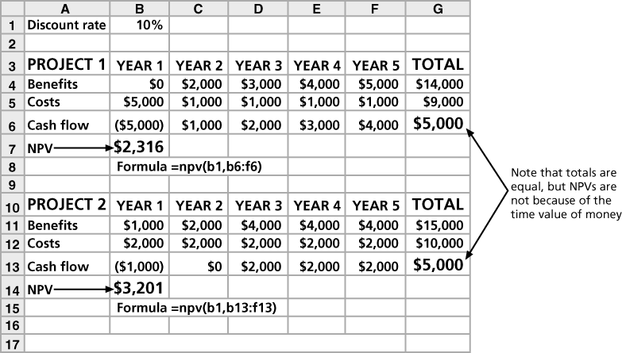
Figure 4-4. Net Present Value Example

Slide 15
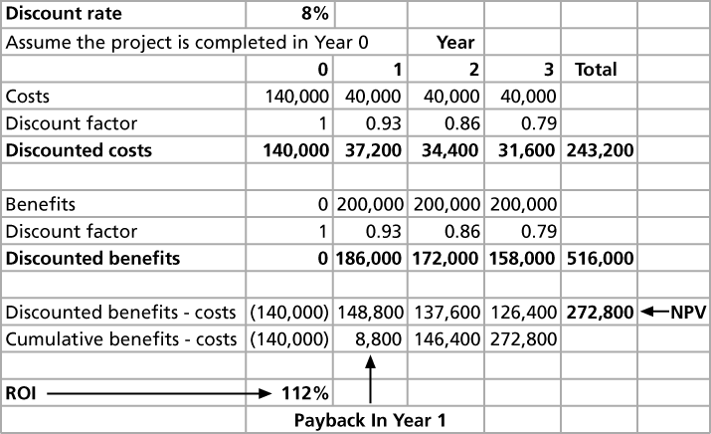
Figure 4-5. JWD Consulting NPV Example

Slide 16
Return on Investment
Return on investment (ROI) is calculated by subtracting the project costs from the benefits and then dividing by the costs
ROI = (total discounted benefits - total discounted costs) / discounted costs
The higher the ROI, the better
Many organizations have a required rate of return or minimum acceptable rate of return on investment for projects
Internal rate of return (IRR) can by calculated by finding the discount rate that makes the NPV equal to zero

Slide 17
Payback Analysis
Another important financial consideration is payback analysis
The payback period is the amount of time it will take to recoup, in the form of net cash inflows, the total dollars invested in a project
Payback occurs when the net cumulative discounted benefits equals the costs
Many organizations want IT projects to have a fairly short payback period

Slide 18
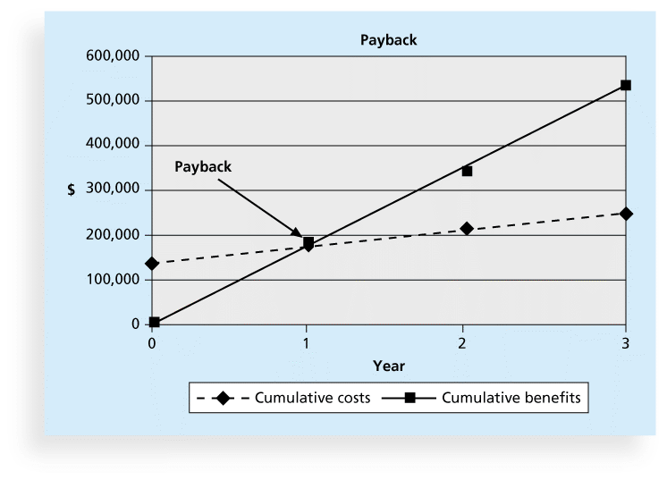
Figure 4-6. Charting the Payback Period

Slide 19
Weighted Scoring Model
A weighted scoring model is a tool that provides a systematic process for selecting projects based on many criteria
Identify criteria important to the project selection process
Assign weights (percentages) to each criterion so they add up to 100%
Assign scores to each criterion for each project
Multiply the scores by the weights and get the total weighted scores
The higher the weighted score, the better

Slide 20
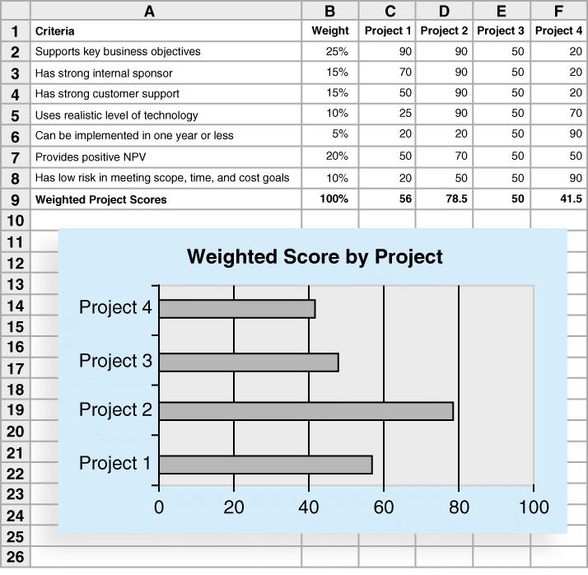
Figure 4-7. Sample Weighted Scoring Model for Project Selection

Slide 21
Implementing a Balanced Scorecard
Drs. Robert Kaplan and David Norton developed this approach to help select and manage projects that align with business strategy
A balanced scorecard
is a methodology that converts an organization’s value drivers, such as customer service, innovation, operational efficiency, and financial performance, to a series of defined metrics
See www.balancedscorecard.org for more information

Slide 22
Developing a Project Charter
After deciding what project to work on, it is important to let the rest of the organization know
A project charter is a document that formally recognizes the existence of a project and provides direction on the project’s objectives and management
Key project stakeholders should sign a project charter to acknowledge agreement on the need and intent of the project; a signed charter is a key output of project integration management

Slide 23
Inputs for Developing a Project Charter
A project statement of work
A business case
Agreements
Enterprise environmental factors
Organizational process assets, which include formal and informal plans, policies, procedures, guidelines, information systems, financial systems, management systems, lessons learned, and historical information

Slide 24
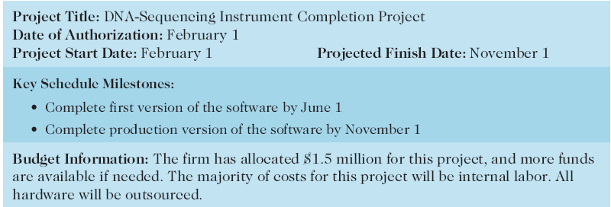
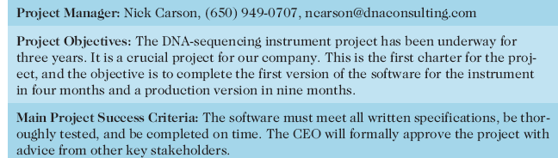
Table 4-1. Project Charter Sample

Slide 25
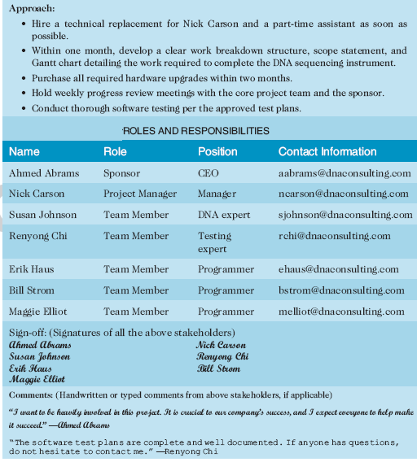
Table 4-1. Project Charter Sample

Slide 26
Developing a PM Plan
A project management plan is a document used to coordinate all project planning documents and help guide a project’s execution and control
Plans created in the other knowledge areas are subsidiary parts of the overall project management plan

Slide 27
Common Elements of a PM Plan
Introduction or overview of the project
Description of how the project is organized
Management and technical processes used on the project
Work to be done, schedule, and budget information

Slide 28
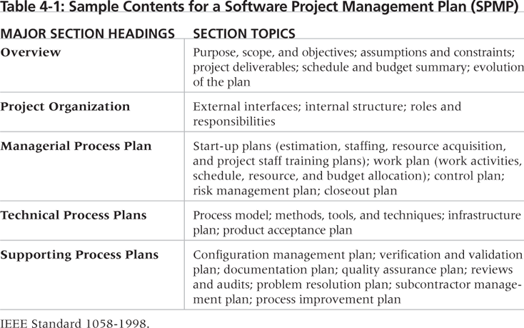
Table 4-2. Sample Contents for a Software PM Plan (SPMP)

Slide 29
Directing and Managing Project Work
Involves managing and performing the work described in the project management plan
The majority of time and money is usually spent on execution
The application area of the project directly affects project execution because the products of the project are produced during execution

Slide 30
Coordinating Planning and Execution
Project planning and execution are intertwined and inseparable activities
Those who will do the work should help to plan the work
Project managers must solicit input from the team to develop realistic plans

Slide 31
Providing Leadership and a Supportive Culture
Project managers must lead by example to demonstrate the importance of creating and then following good project plans
Organizational culture can help project execution by
providing guidelines and templates
tracking performance based on plans
Project managers may still need to break the rules to meet project goals, and senior managers must support those actions

Slide 32
What Went Right?
2015 PMI report found that only 12 percent of organizations were considered to be high performers
Percentage remained unchanged in past few years
Organizations must make major cultural changes to improve

Slide 33
Project Execution Tools and Techniques
Expert judgment: Experts can help project managers and their teams make many decisions related to project execution
Meetings: Meetings allow people to develop relationships, pick up on important body language or tone of voice, and have a dialogue to help resolve problems.
Project management information systems: There are hundreds of project management software products available on the market today, and many organizations are moving toward powerful enterprise project management systems that are accessible via the Internet

Slide 34
Monitoring and Controlling Project Work
Changes are inevitable on most projects, so it’s important to develop and follow a process to monitor and control changes
Monitoring project work includes collecting, measuring, and disseminating performance information
A baseline is the approved project management plan plus approved changes

Slide 35
Performing Integrated Change Control
Three main objectives are:
Influencing the factors that create changes to ensure that changes are beneficial
Determining that a change has occurred
Managing actual changes as they occur

Slide 36
Change Control on Information Technology Projects
Former view: The project team should strive to do exactly what was planned on time and within budget
Problem: Stakeholders rarely agreed up-front on the project scope, and time and cost estimates were inaccurate
Modern view: Project management is a process of constant communication and negotiation
Solution: Changes are often beneficial, and the project team should plan for them

Slide 37
Change Control System
A change control system is a formal, documented process that describes when and how official project documents and work may be changed
Describes who is authorized to make changes and how to make them

Slide 38
Change Control Board (CCB)
A change control board is a formal group of people responsible for approving or rejecting changes on a project
CCBs provide guidelines for preparing change requests, evaluate change requests, and manage the implementation of approved changes
Includes stakeholders from the entire organization

Slide 39
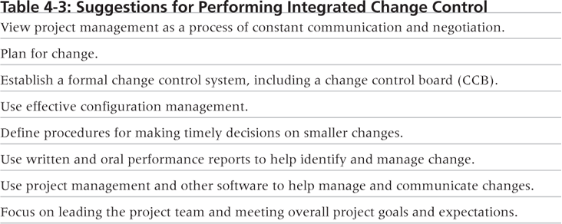
Table 4-3. Suggestions for Performing Integrated Change Control

Slide 40
Closing Projects or Phases
To close a project or phase, you must finalize all activities and transfer the completed or cancelled work to the appropriate people
Main outputs include
Final product, service, or result transition
Organizational process asset updates

Slide 41
Using Software to Assist in Project Integration Management
Several types of software can be used to assist in project integration management
Documents can be created with word processing software
Presentations are created with presentation software
Tracking can be done with spreadsheets or databases
Communication software can facilitate communications
Project management software can pull everything together and show detailed and summarized information

Slide 42
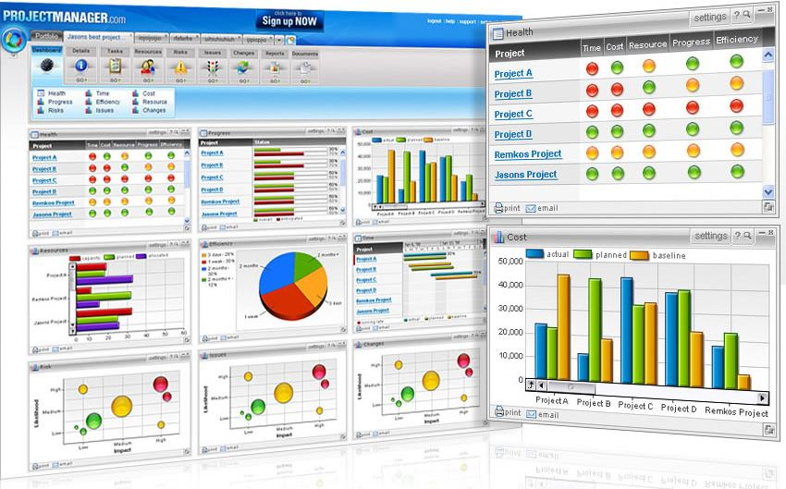
Figure 4-8. Sample Portfolio Management Software Screen

Slide 43
Chapter Summary
Project integration management involves coordinating all of the other knowledge areas throughout a project’s life cycle
Main processes include
Develop the project charter
Develop the project management plan
Direct and manage project execution
Monitor and control project work
Perform integrated change control
Close the project or phase

Slide 44
Questions & answers

